Slide 1

ST. THOMAS COLLEGE (AUTONOMOUS), THRISSUR
Affiliated to University of Calicut Nationally reaccredited with ‘A++’ Grade
TERM PAPER PRESENTATION
Date : 19.02.2026
Variational Quantum Machine Learning on NISQ Devices
Mr. Rejin Varghese Research Supervisor
HOD
Dept. of Data Science
THARIYAN NIRMAL JOHN
S 6 B. VOC DATA SCIENCE
REG. NO : THAXBOA022
1

Slide 2
OUTLINE
Abstract
Introduction
Dataset Description
Literature Review
Result and Discussion
Conclusion
Output
References

Slide 3
ABSTRACT
Quantum computing is an emerging technology that has the potential to solve certain problems faster than classical computers, but today’s quantum machines are still small and affected by noise, which limits their performance.
This paper reviews a hybrid learning approach called Variational Quantum Machine Learning (VQML), which combines simple quantum circuits with classical optimization methods to make quantum models usable on current noisy and limited quantum hardware.
Five widely studied VQML algorithms — Variational Quantum Classifier (VQC), Quantum Support Vector Machine (QSVM), Quantum Neural Network (QNN), Quantum Convolutional Neural Network (QCNN), and Variational Quantum Feature Embedding (VQFE) — are examined based on their design, training behavior, and performance.
The review highlights major challenges faced by these models, such as training difficulties (including vanishing gradients) and the impact of hardware noise on accuracy, as well as modern techniques developed to reduce these issues.
A standardized experimental setup using a binary subset of the MNIST dataset (digits 2 and 7) is proposed to evaluate all five algorithms fairly, focusing on accuracy, stability, and resistance to noise.

Slide 4
ABSTRACT
Findings from recent research and practical tests suggest that VQML can offer advantages in certain learning tasks but still requires improvements in algorithm design, optimization strategies, and noise-handling techniques.
This review contributes toward understanding how current quantum systems can be used for machine learning and how these models can be improved as quantum hardware continues to advance.

Slide 5
INTRODUCTION
Quantum computing aims to solve certain problems faster than classical computers by using quantum principles such as superposition and entanglement. However, today’s quantum devices, known as NISQ (Noisy Intermediate-Scale Quantum) devices, are limited by small qubit counts and hardware noise.
Because of these limitations, running large and complex quantum algorithms is not practical. This makes it important to explore methods that can work effectively on current noisy hardware.
Variational Quantum Machine Learning (VQML) has become one of the most promising approaches for using quantum computers today. VQML combines simple quantum circuits with classical optimization techniques, allowing learning tasks to run even on noisy and small quantum processors.
This paper provides a detailed review of VQML techniques and explores how different variational models—such as Variational Quantum Classifiers (VQC), Quantum Support Vector Machines (QSVM), Quantum Neural Networks (QNN), Quantum Convolutional Neural Networks (QCNN), and Variational Quantum Feature Embedding (VQFE)—perform under real NISQ conditions.
VQML models must overcome challenges such as training instability (including barren plateaus where learning becomes extremely slow) and the negative effects of hardware noise, which can reduce accuracy and reliability.
5

Slide 6
INTRODUCTION
This study also discusses how error-mitigation techniques, such as zero-noise extrapolation and measurement correction, help improve the performance of quantum models without requiring full error correction.
By reviewing the strengths, limitations, and practical behavior of variational algorithms, this paper aims to provide a clear understanding of how quantum machine learning can be used today and how these models can be improved for future, more powerful quantum computers.
6

Slide 7
DATASET DESCRIPTION
Dataset Description
This study uses a structured subset of the popular MNIST Handwritten Digit Dataset, focused specifically on binary image classification between digits “2” and “7”. The dataset contains thousands of grayscale handwritten digit images, each representing a unique handwriting style. These two digits are chosen because they are visually similar in shape but still separable, making them ideal for testing and comparing Variational Quantum Machine Learning (VQML) algorithms on NISQ devices.
The dataset is preprocessed to convert each 28×28 pixel image into a smaller and more manageable 4×4 representation, allowing the data to fit within the qubit limits of current noisy quantum hardware. This reduced-dimension version ensures that all five quantum machine learning algorithms can be trained and evaluated consistently using the same set of inputs. The dataset is well-suited for benchmarking quantum models in classification tasks, particularly under noise and size constraints typical of NISQ devices.

Slide 8
DATASET DESCRIPTION
4.1.Feature Description
The dataset contains image features, pixel intensity values, and a binary class label. Each sample includes the following:
1. Image-Based Features (After Preprocessing)
Each handwritten digit image is represented using a reduced 4×4 grid (16 pixel intensities):
Pixel values range between 0 and 255 (converted to 0–1 during normalization).
Each pixel intensity represents the darkness/brightness of a specific region in the digit image.
These 16 pixel values form the input features for all quantum algorithms.
2. Encoded Quantum Features
After preprocessing, the pixel values are encoded for quantum circuits using:
Angle Encoding: Each pixel is mapped to a rotation angle θ = (pixel_value × π).
These encoded angles serve as direct inputs to parameterized quantum circuits used by VQC, QSVM, QNN, QCNN, and VQFE.

Slide 9
DATASET DESCRIPTION
3. Additional Processing Features (Optional)
To reduce noise or dimensionality, the dataset may include:
Normalized pixel features (scaled 0–1)
Principal Component Analysis (PCA) features (4–8 dimensions) These optional features help evaluate how different quantum models react to various forms of preprocessing.
4.2Target Variable (Digit Classification)
Digit Label (Binary Target Variable)
Label = 0 → Digit “2”
Label = 1 → Digit “7”
The target variable indicates which digit the image represents. This binary classification setup ensures that:
All five VQML algorithms can be compared fairly
Evaluation metrics remain consistent
The dataset matches typical VQML benchmark settings used in research studies

Slide 10
LITERATURE SURVEY
1.Variational Quantum Classifier (VQC) [6] [13]
The Variational Quantum Classifier (VQC) is a supervised learning algorithm designed specifically for classification problems. It combines quantum feature encoding with a trainable quantum circuit to learn decision boundaries between different classes.
The algorithm first encodes classical data into quantum states and then applies a parameterized ansatz that transforms these states into a new feature space. Measurements of specific observables determine the predicted class labels.

Slide 11
LITERATURE SURVEY
2.Quantum Neural Network (QNN) [4]
Quantum Neural Networks (QNNs) are learning models inspired by classical neural networks but implemented using quantum circuits. Instead of classical weights and neurons, QNNs use qubits and parameterized quantum gates to perform computation.
Input data is first encoded into quantum states using feature maps. These states are then passed through multiple variational layers where trainable gates modify the amplitudes and phases of the qubits.
After processing, measurements are taken to produce outputs and a loss function is computed. A classical optimizer updates the parameters to improve performance, and due to their shallow depth and fewer parameters, QNNs are easier to train on noisy hardware.

Slide 12
LITERATURE SURVEY
During training, the parameters are adjusted to minimize classification error using classical optimization. Because VQC uses shallow circuits and hybrid optimization, it requires fewer quantum resources and performs reliably even in the presence of noise, making it one of the most practical algorithms for real NISQ-based quantum machine learning.

Slide 13
LITERATURE SURVEY
3.Quantum Convolutional Neural Network (QCNN) [4]
Quantum Convolutional Neural Networks (QCNNs) are quantum versions of classical convolutional neural networks that use local operations to extract important features from data. The circuit is structured into convolution layers that apply unitary gates to neighboring qubits and pooling layers that reduce the number of qubits by combining or discarding less important information.
This hierarchical structure allows QCNNs to progressively compress information while preserving relevant patterns. As a result, fewer parameters are required compared to fully connected circuits, and the training process becomes more stable.

Slide 14
LITERATURE SURVEY
QCNNs also avoid the barren plateau problem, where gradients vanish during training. These properties make QCNNs highly efficient and suitable for implementation on NISQ devices.

Slide 15
LITERATURE SURVEY
4.Quantum Support Vector Machine (QSVM) [6]
Quantum Support Vector Machine (QSVM) is a quantum-enhanced version of the classical support vector machine algorithm. Instead of computing similarity between data points using classical kernels, QSVM uses a quantum computer to embed data into a high-dimensional Hilbert space and calculate quantum kernels.
These kernel values measure the similarity between samples and are then passed to a classical SVM to determine the optimal decision boundary. By exploiting quantum feature spaces that are difficult to simulate classically, QSVM can achieve better separation of complex data.

Slide 16
LITERATURE SURVEY
Since only the kernel computation is quantum and the rest is classical, the method requires shallow circuits and is highly suitable for NISQ hardware.

Slide 17
LITERATURE SURVEY
5.Variational Quantum Feature Embedding (VQFE)
Variational Quantum Feature Embedding (VQFE) is a trainable data encoding technique used to map classical inputs into quantum states. Unlike fixed feature maps that remain constant, VQFE introduces adjustable parameters in the encoding circuit.
During training, these parameters are optimized so that the embedding better separates different classes of data. This adaptive encoding improves model accuracy and reduces the burden on later layers of the quantum circuit.
Because it increases expressiveness without increasing circuit depth, VQFE helps create efficient and noise-resilient models, which is especially important for learning tasks on NISQ devices.

Slide 18
RESULT AND DISCUSSION
Evaluation Metrices
Accuracy : Accuracy is the ratio of correct predictions to the total predictions(The overall accuracy)
Precision : Precision is the ratio of correctly predicted positive observations to the total predicted positives(For Example: For every 100 predictions of class 2, only ~19 are correct.)
Recall : Recall is the ratio of correctly predicted positive observations to the actual positives(For Example: While the model predicts class 2 often, it still misses many actual class 2 instances)
F1-Score : The F1-score is the harmonic mean of precision and recall, balancing both metrics(balance between precision and recall.)

Slide 19
RESULT AND DISCUSSION
Evaluation Metrices
ALGORITHMS | ACCURACY | PRECISION | RECALL | F1-SCORE
VQC | 96.40% | 0.942 | 0.992 | 0.966
QNN | 52.80% | 0.528 | 1.000 | 0.691
QCNN | 96.40% | 0.942 | 0.992 | 0.966
QSVM | 90.00% | 0.928 | 0.928 | 0.928
VQFE | 57.60% | 0.591 | 0.636 | 0.613

Slide 20
RESULT AND DISCUSSION
In this study, we evaluated five variational quantum machine learning algorithms for binary image classification (MNIST digits 2 vs 7) on a simulated NISQ environment. Each algorithm employs a 4-qubit quantum circuit with PCA-based dimensionality reduction (784 → 4 principal components). The evaluation was based on four key metrics: Accuracy, Precision, Recall, and F1-Score. The models analyzed include Variational Quantum Classifier (VQC), Quantum Neural Network (QNN), Quantum Convolutional Neural Network (QCNN), Quantum Support Vector Machine (QSVM), and Variational Quantum Feature Embedding (VQFE).
Best Performing Models: Both VQC and QCNN achieve the highest accuracy (96.40%), precision (0.942), recall (0.992), and F1-score (0.966). Notably, QCNN achieves this with only 6 trainable parameters compared to VQC's 36, making it the most parameter-efficient model and the most practical candidate for real NISQ hardware deployment.

Slide 21
RESULT AND DISCUSSION
QSVM as the Second Best: The QSVM model follows with an accuracy of 90.00% and a balanced F1-score of 0.928, making it the third most effective algorithm. Its kernel-based approach requires no iterative circuit training, making it immune to barren plateau issues and a robust alternative when training stability is a priority.
Under-performing Models: The QNN model (52.80% accuracy) converges to a near-trivial solution with perfect recall (1.000) but poor precision (0.528), indicating it classifies almost all samples as a single class. Similarly, VQFE achieves only 57.60% accuracy, suggesting that simpler entanglement layers (BasicEntanglerLayers) and joint encoding-classification optimization struggle in low-qubit settings. This demonstrates that circuit architecture design is more critical than circuit depth for quantum classification performance.

Slide 22
CONCLUSION
As quantum computing transitions from theoretical research to practical applications, the integration of variational quantum algorithms with classical preprocessing techniques like PCA could pave the way for more efficient and hardware-aware quantum classification solutions on near-term NISQ devices.
NISQ-era quantum computing presents both promising opportunities and inherent challenges. Our evaluation demonstrates that quantum circuit architectures such as VQC and QCNN can achieve classification accuracy as high as 96.40%, while operating within the strict constraints of limited qubits and shallow circuit depths that characterize current quantum hardware.
Ultimately, as quantum hardware scales beyond the NISQ era with more qubits and lower error rates, the variational algorithms benchmarked in this study have the potential to unlock quantum advantage in real-world machine learning, offering capabilities that surpass classical approaches for complex classification problems.
These kinds of benchmarking studies are not just about achieving higher accuracy, but about building a foundational understanding of which quantum circuit designs and encoding strategies will drive the next generation of quantum-powered AI — bridging the gap between today's noisy processors and tomorrow's fault-tolerant quantum computers.

Slide 23
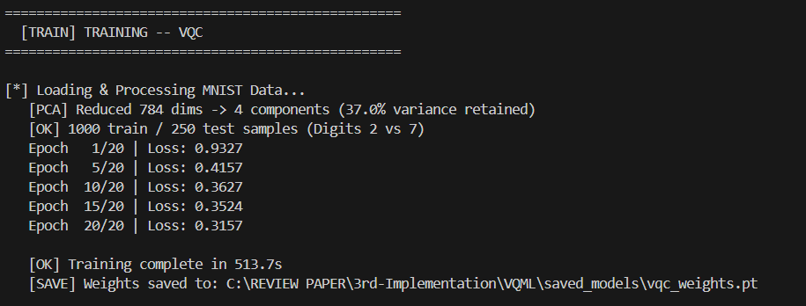
OUTPUT
Variational Quantum Classifier (VQC)

Slide 24
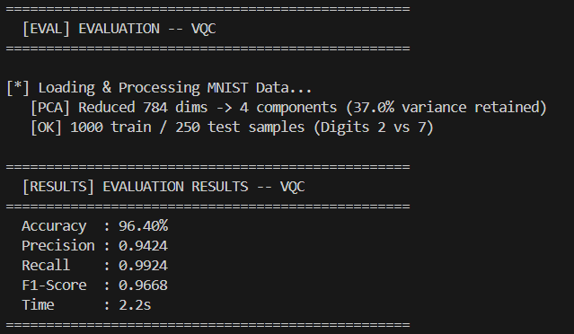
OUTPUT
Variational Quantum Classifier (VQC)

Slide 25
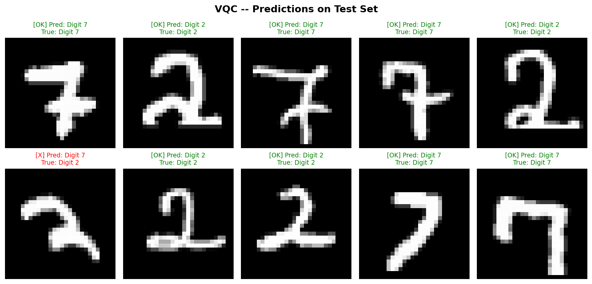
OUTPUT
Variational Quantum Classifier (VQC)

Slide 26
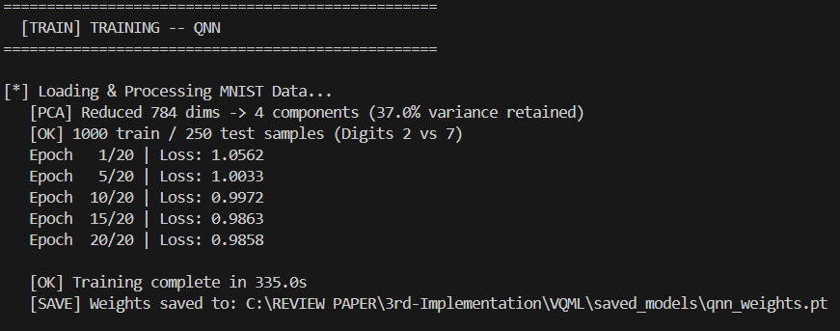
OUTPUT
Quantum Neural Network (QNN)

Slide 27
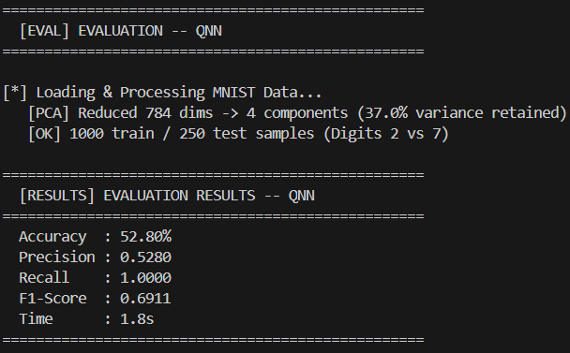
OUTPUT
Quantum Neural Network (QNN)

Slide 28
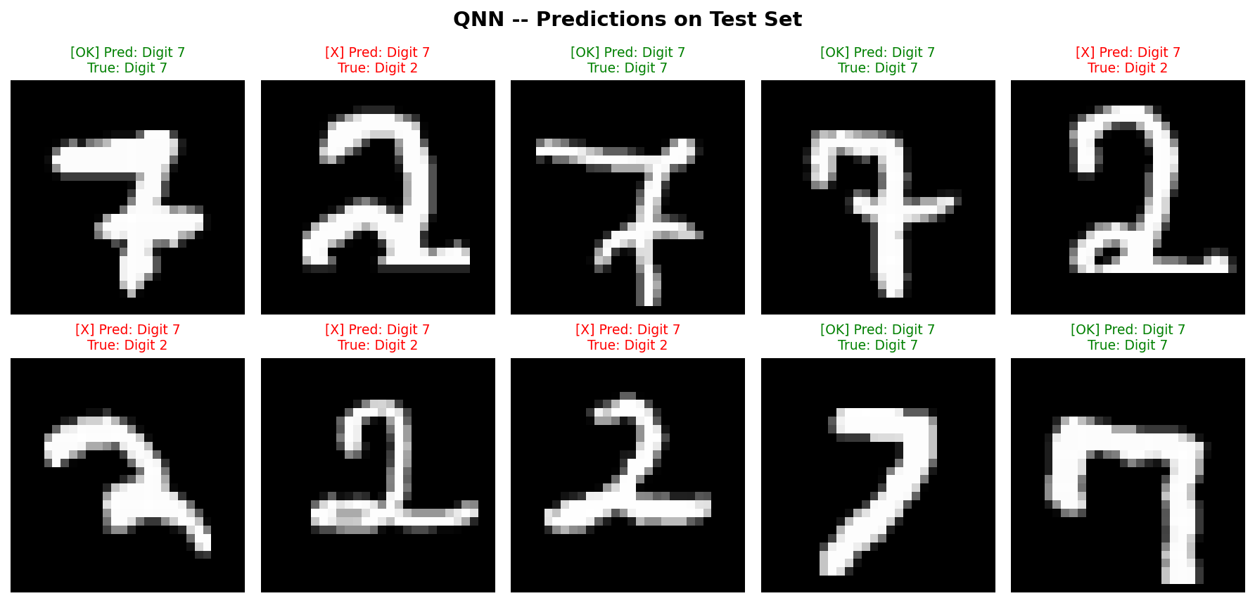
OUTPUT
Quantum Neural Network (QNN)

Slide 29
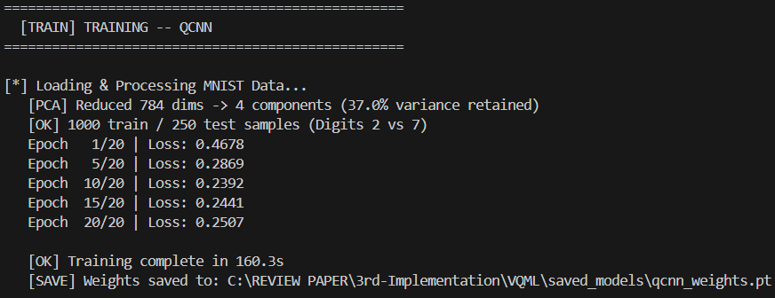
OUTPUT
Quantum Convolutional Neural Network (QCNN)

Slide 30
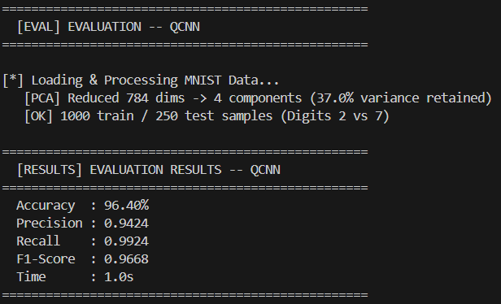
OUTPUT
Quantum Convolutional Neural Network (QCNN)

Slide 31

OUTPUT
Quantum Convolutional Neural Network (QCNN)

Slide 32
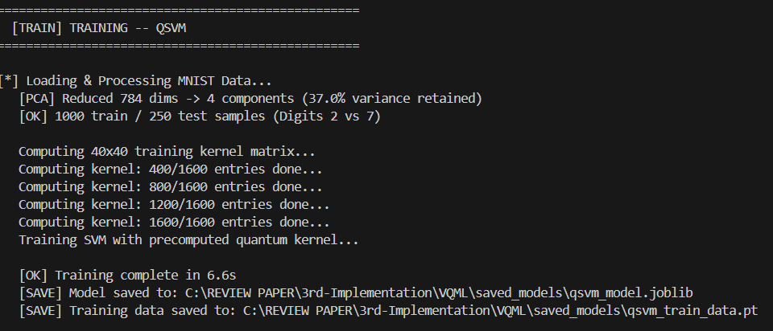
OUTPUT
Quantum Support Vector Machine (QSVM)

Slide 33
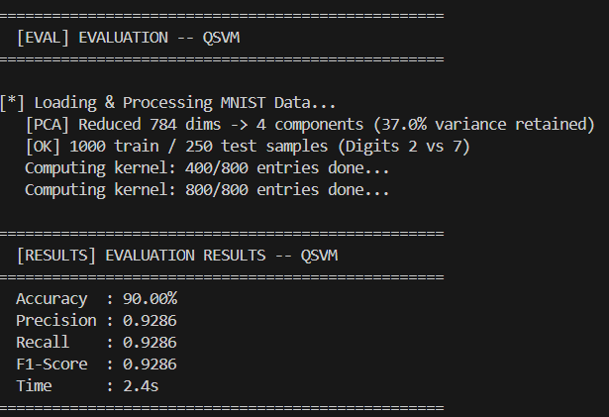
OUTPUT
Quantum Support Vector Machine (QSVM)

Slide 34
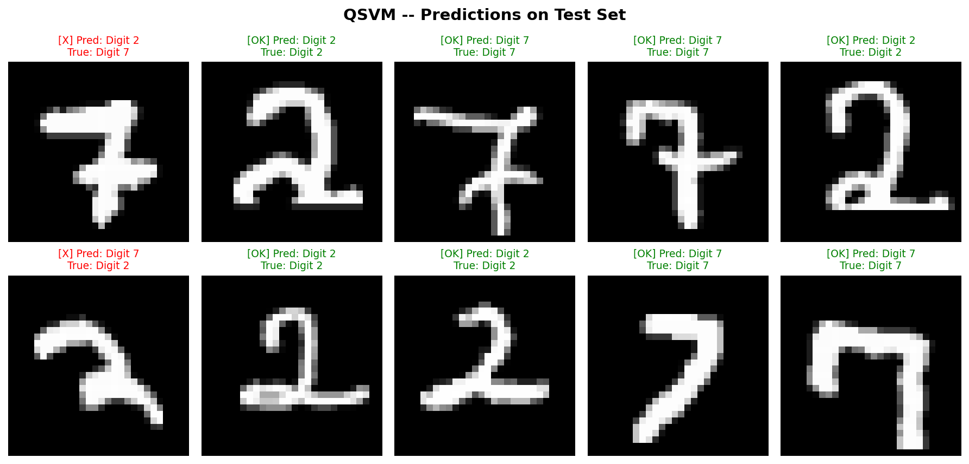
OUTPUT
Quantum Support Vector Machine (QSVM)

Slide 35

OUTPUT
Variational Quantum Feature Embedding (VQFE)

Slide 36
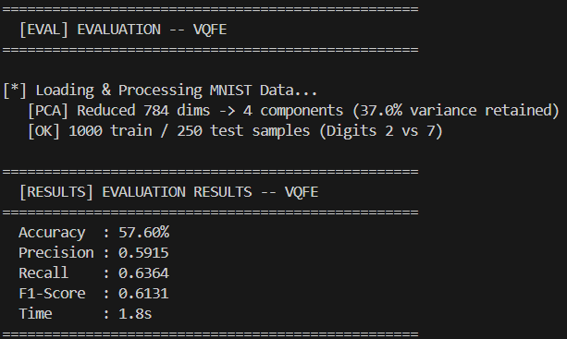
OUTPUT
Variational Quantum Feature Embedding (VQFE)

Slide 37
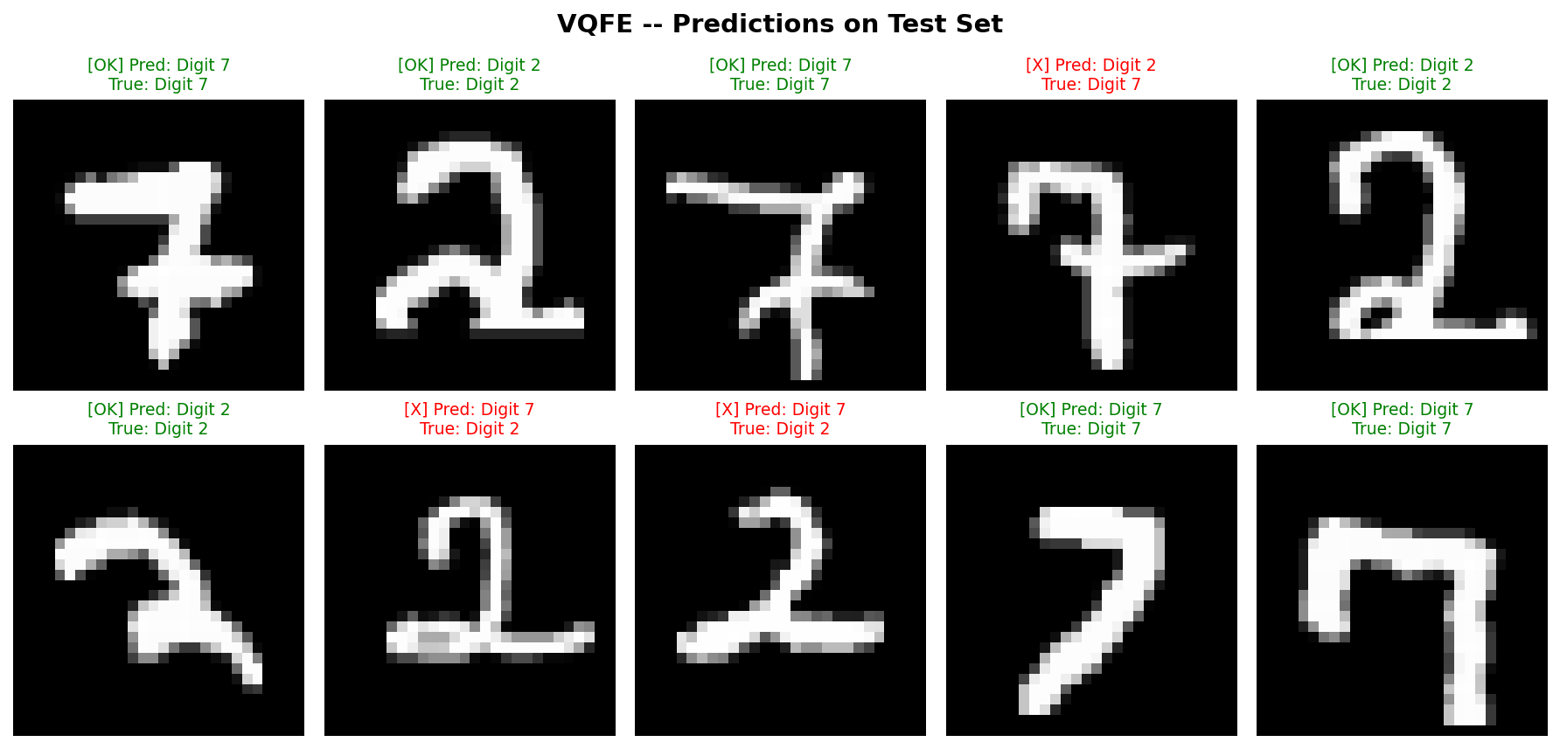
OUTPUT
Variational Quantum Feature Embedding (VQFE)

Slide 38
REFERENCES
C. N. Self et al., "Variational quantum algorithm with information sharing," npj Quantum Inf., vol. 7, no. 1, p. 116, Jul. 2021, doi: 10.1038/s41534-021-00452-9.
M. Larocca, P. Czarnik, K. Sharma, G. Muraleedharan, P. J. Coles, and M. Cerezo, "Diagnosing barren plateaus with tools from quantum optimal control," Quantum, vol. 6, p. 824, Sep. 2022, doi: 10.22331/q-2022-09-29-824.
A. Arrasmith, Z. Holmes, M. Cerezo, and P. J. Coles, "Equivalence of quantum barren plateaus to cost concentration and narrow gorges," Quantum Sci. Technol., vol. 7, no. 4, p. 045015, Oct. 2022, doi: 10.1088/2058-9565/ac7d06.
C. Zhao and X.-S. Gao, "Analyzing the barren plateau phenomenon in training quantum neural networks with the ZX-calculus," Quantum, vol. 5, p. 466, Jun. 2021, doi: 10.22331/q-2021-06-04-466.
X. Wang, Y. Du, Y. Luo, and D. Tao, "Towards understanding the power of quantum kernels in the NISQ era," Quantum, vol. 5, p. 531, Aug. 2021, doi: 10.22331/q-2021-08-30-531.
J. Jäger and R. V. Krems, "Universal expressiveness of variational quantum classifiers and quantum kernels for support vector machines," Nat. Commun., vol. 14, no. 1, p. 576, Feb. 2023, doi: 10.1038/s41467-023-36144-5.
S. Jerbi et al., "Quantum machine learning beyond kernel methods," Nat. Commun., vol. 14, no. 1, p. 517, Jan. 2023, doi: 10.1038/s41467-023-36159-y.

Slide 39
REFERENCES
R. Shaydulin and S. M. Wild, "Importance of kernel bandwidth in quantum machine learning," Phys. Rev. A, vol. 106, no. 4, p. 042407, Oct. 2022, doi: 10.1103/PhysRevA.106.042407.
R. LaRose et al., "Mitiq: A software package for error mitigation on noisy quantum computers," Quantum, vol. 6, p. 774, Aug. 2022, doi: 10.22331/q-2022-08-11-774.
T. Kurita, H. Qassim, M. Ishii, H. Oshima, S. Sato, and J. Emerson, "Synergetic quantum error mitigation by randomized compiling and zero-noise extrapolation for the variational quantum eigensolver," Quantum, vol. 7, p. 1184, Nov. 2023, doi: 10.22331/q-2023-11-20-1184.
R. LaRose, A. Mari, P. J. Coles, P. J. Karalekas, N. Shammah, and W. J. Zeng, "Increasing the measured effective quantum volume with zero noise extrapolation," ACM Trans. Quantum Comput., vol. 5, no. 4, pp. 1–21, Dec. 2024, doi: 10.1145/3680290.
Y. Hama and H. Nishi, "Quantum error mitigation via quantum-noise-effect circuit groups," Sci. Rep., vol. 12, no. 1, p. 8945, May 2022, doi: 10.1038/s41598-022-12797-2.
S. Wang, Y. Shen, X. Liu, H. Zhang, and Y. Wang, "Variational quantum entanglement classification discrimination," Physica A, vol. 637, p. 129530, Mar. 2024, doi: 10.1016/j.physa.2024.129530.
T.-R. Jin et al., "Purity-assisted zero-noise extrapolation for quantum error mitigation," Adv. Quantum Technol., vol. 7, no. 8, p. 2400150, Aug. 2024, doi: 10.1002/qute.202400150.
J. Schnabel and M. Roth, "Quantum kernel methods under scrutiny: A benchmarking study," Quantum Mach. Intell., vol. 7, no. 1, p. 58, 2025, doi: 10.1007/s42484-025-00273-5.

